Slide 1

Lead Score Case Study

Slide 2

Lead Score Case Study for X Education
Problem Statement :
X Education sells online courses to industry professionals. The company markets its courses on several websites and search engines like Google.
Once these people land on the website, they might browse the courses or fill up a form for the course or watch some videos. When these people fill up a form providing their email address or phone number, they are classified to be a lead. Moreover, the company also gets leads through past referrals. Once these leads are acquired, employees from the sales team start making calls, writing emails, etc. Through this process, some of the leads get converted while most do not. The typical lead conversion rate at X education is around 30%.
Business Goal:
X Education needs help in selecting the most promising leads, i.e. the leads that are most likely to convert into paying customers.
The company needs a model wherein you a lead score is assigned to each of the leads such that the customers with higher lead score have a higher conversion chance and the customers with lower lead score have a lower conversion chance. The CEO, in particular, has given a ballpark of the target lead conversion rate to be around 80%.

Slide 3

Strategy
Inspecting the data for analysis
Clean and prepare the data
Exploratory Data Analysis.
Feature Scaling
Splitting the data into Test and Train dataset.
Building a logistic Regression model and calculate Lead Score.
Evaluating the model by using different metrics.
Applying the best model in Test data based on the Sensitivity and Specificity Metrics and majorly by Accuracy.

Slide 4
Problem solving methodology
Data Sourcing , Cleaning and Preparation
Read the Data from Source
Convert data into clean format suitable for analysis
Remove duplicate data
Outlier Treatment
Exploratory Data Analysis
Feature Standardization.
Feature Scaling and Splitting Train and Test Sets
Feature Scaling of Uniform data
Splitting data into train and test set.
Model Building
Feature Selection using RFE
Determine the optimal model
using Logistic Regression
Calculate various metrics like accuracy, sensitivity, specificity, precision and recall and evaluate the model.
Result
Determine the lead score and check if target final predictions amounts to 80% conversion rate.
Evaluate the final prediction on the test set using cut off threshold from sensitivity and specificity metrics

Slide 5
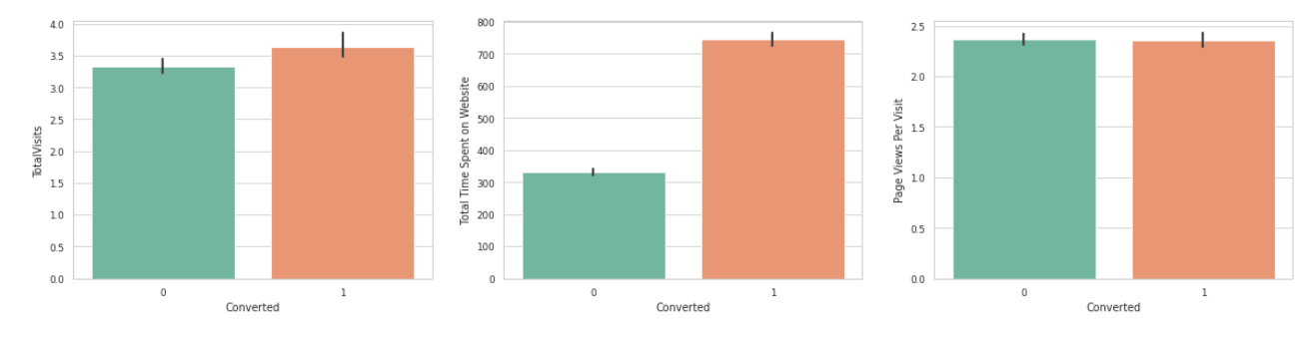
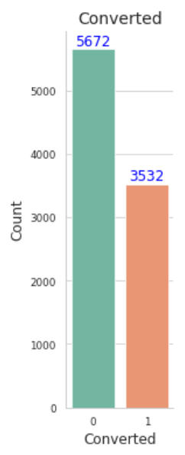
Exploratory Data Analysis
We have around 65% Conversion rate in Total
The conversion rates were high for Total Visits, Total Time Spent on Website and Page Views Per Visit
.

Slide 6
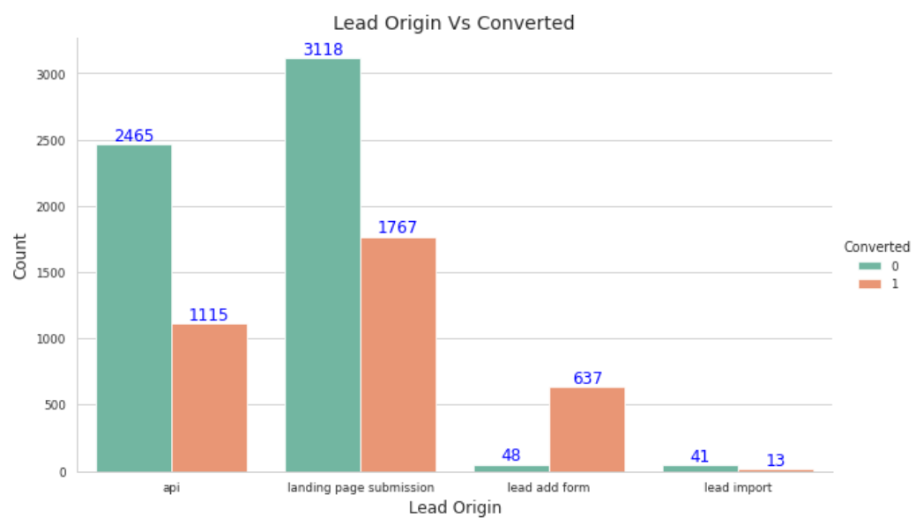
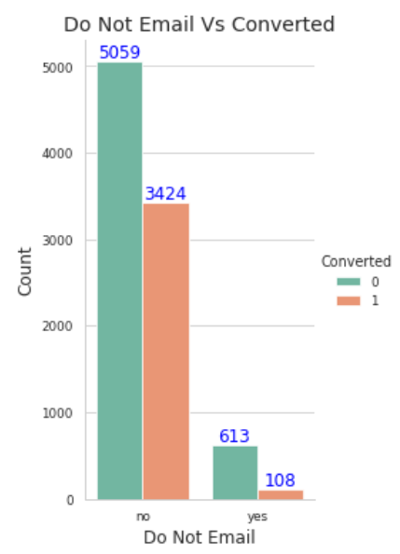
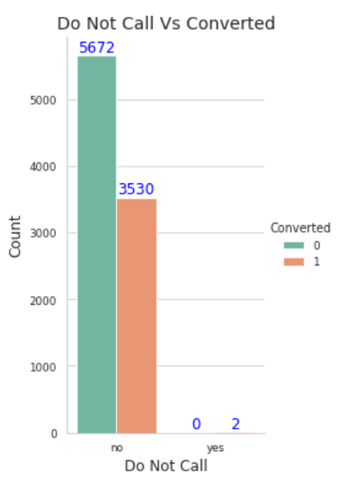
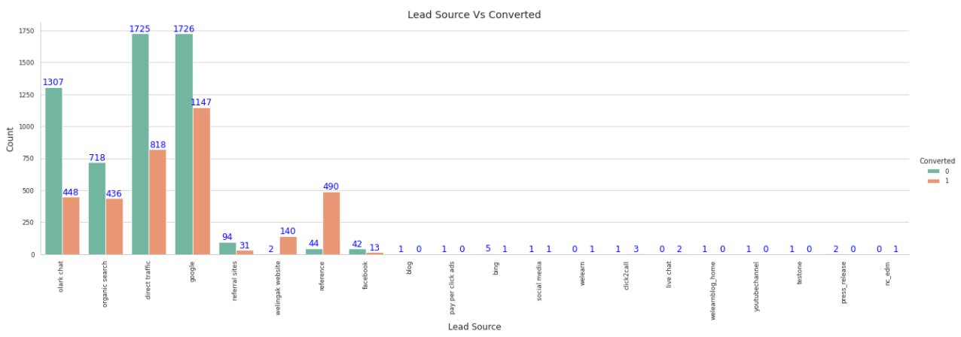
In Lead Origin, maximum conversion happened from Landing Page Submission
Major conversion has happened from Emails sent and Calls made
Major conversion in the lead source is from Google

Slide 7
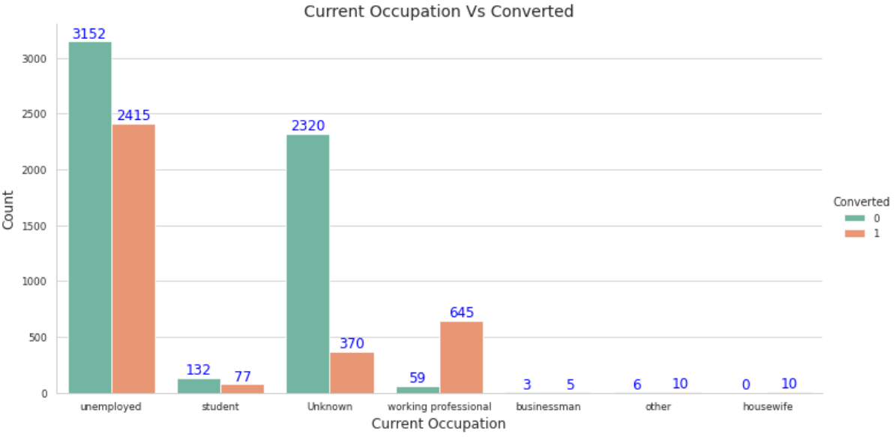
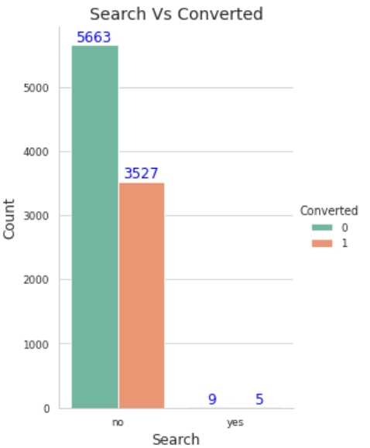
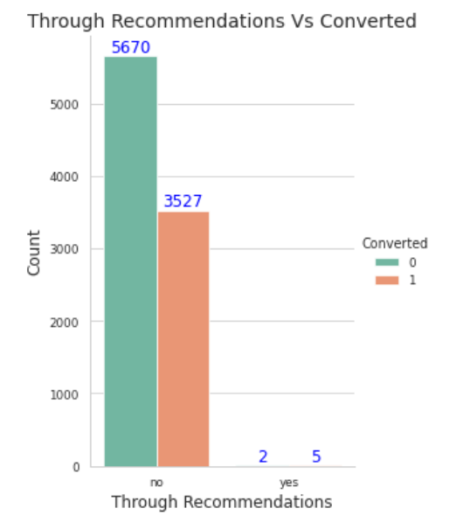

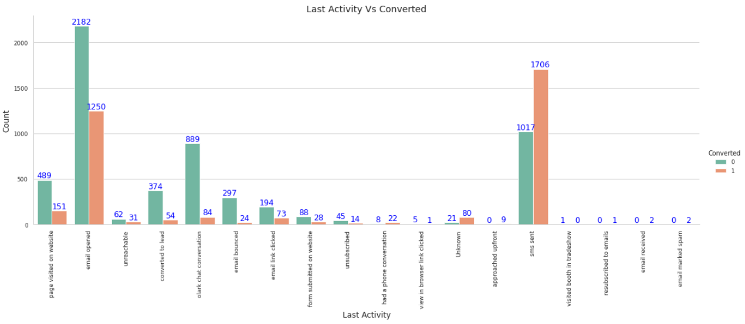
More conversion happened with people who are unemployed
Not much impact on conversion rates through Search, digital advertisements and through recommendations
Last Activity value of SMS Sent' had more conversion.

Slide 8
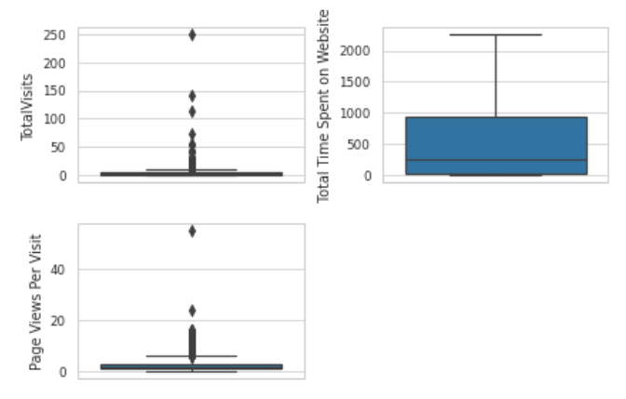

Outlier Treatment for all three numerical variables.
Fitting data between IQR

Slide 9

DATA PREPARATION:
Getting Dummies variable for columns
Dropping records with unknown values
Test Train split
Feature Scaling for uniform scale of data (using standard scaler)
Building Initial Model
Feature Selection (20 Variables)

Slide 10
Variables Impacting the Conversion Rate
'Last Activity_sms sent’
'Tags_already a student’
'Tags_closed by horizzon’
'Tags_diploma holder (not eligible)’
'Tags_interested in full time mba’
'Tags_interested in other courses’
'Tags_invalid number’
'Tags_lost to eins’
'Tags_not doing further education’
'Tags_number not provided’
'Tags_opp hangup’
'Tags_ringing’
'Tags_switched off’
'Tags_will revert after reading the email’
'Tags_wrong number given’
'Asymmetrique Activity Index_03.low’
'Lead Quality_worst’
'What is your current occupation_unemployed’
'What is your current occupation_working professional’
'Lead Source_welingak website'

Slide 11
Creating a dataframe with the actual churn flag and the predicted probabilities
keeping a threshold of P >= 0.5 for conversion
Optimizing the model for P- values and VIF
Confusion Matrix
3665 91
440 1854
Accuracy - 91%
Sensitivity - 80 %
Specificity - 97 %
False Positive Rate - 24 %
Positive Predictive Value - 95%
Positive Predictive Value – 89%

Slide 12
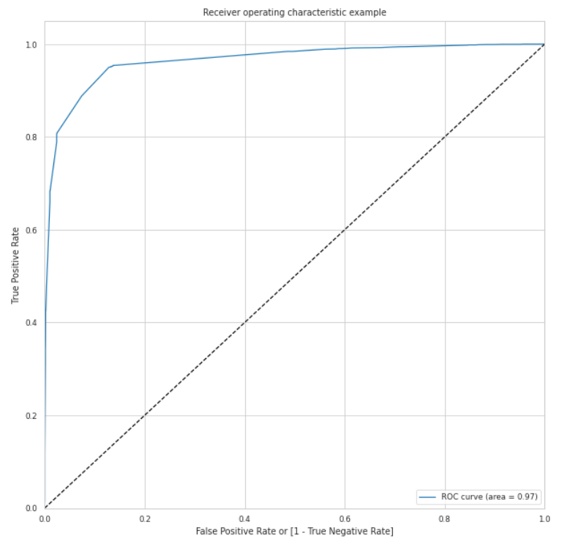

ROC Curve for Train set
Area under the curve is : 0.97

Slide 13
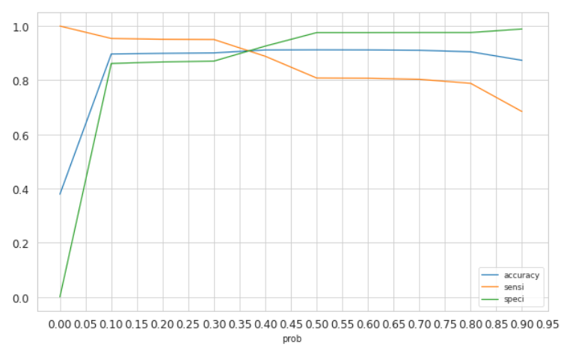
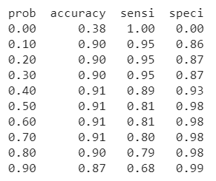
The graph depicts an optimal cut off of 0.35 based on Accuracy, Sensitivity and Specificity

Slide 14

Model Evaluation - on Train Data Set
Confusion Matrix
3271 485
114 2180
Accuracy - 90%
Sensitivity - 95 %
Specificity - 87 %
False Positive Rate - 21%
Positive Predictive Value - 82%
Positive Predictive Value – 97%
Precision - 82 %
Recall - 95 %

Slide 15
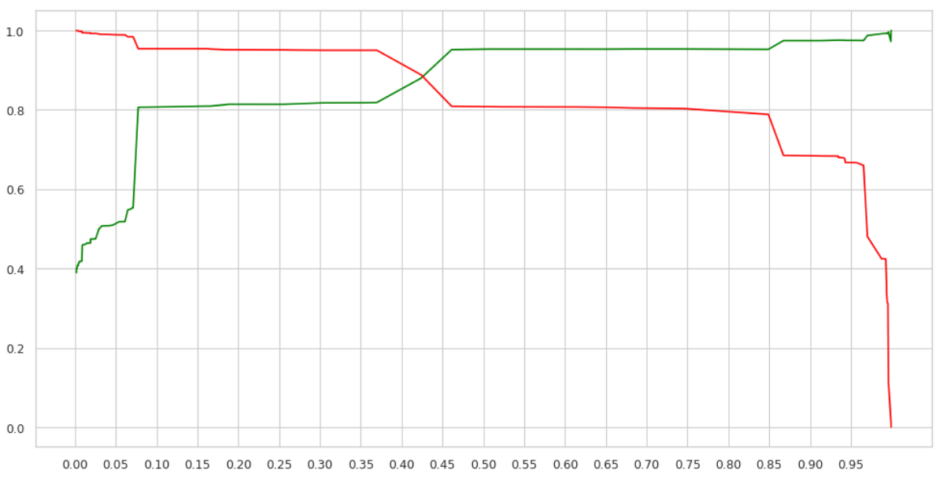
Graph above shows that, we get the optical threshold value as close to .42. However our target is to have Lead Conversion Rate around 80%
F1 Score:
88 %

Slide 16
Model Evaluation – on Test Dataset
Using the probability threshold value 0f 0.35 on the test dataset to predict if a lead will convert
Confusion Matrix
1350 234
49 960
F1 Score:
87 %
Accuracy - 89%
Sensitivity - 95 %
Specificity - 85 %
False Positive Rate - 14%
Positive Predictive Value - 80%
Positive Predictive Value – 96%
Precision - 80 %
Recall - 95 %

Slide 17
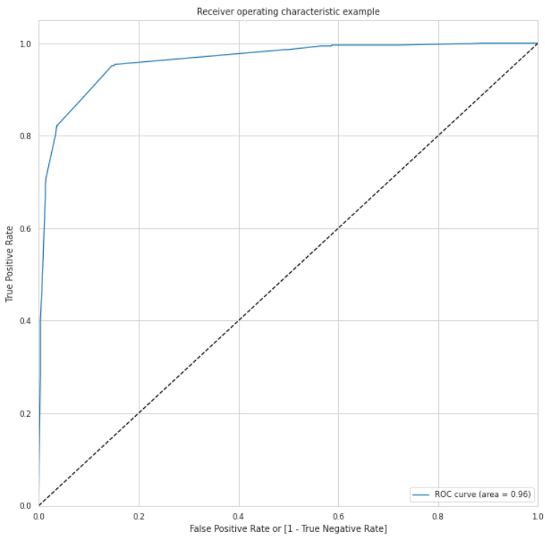
ROC Curve for Test set
Area under the curve is : 0.96

Slide 18

Determining Feature Importance - which factors lead to Lead conversion the most.
Tags_lost to eins
Tags_closed by horizzon
Tags_will revert after reading the email
What is your current occupation_working professional
What is your current occupation_unemployed
Last Activity_sms sent
Lead Quality_worst
Asymmetrique Activity Index_03.low
Tags_opp hangup
Tags_interested in full time mba

Slide 19
Conclusion
Accuracy, Sensitivity and Specificity values of test set are around 89%, 95% and 85% which are approximately closer to the respective values calculated using trained set.
Also the lead score calculated shows the conversion rate on the final predicted model is around 88% (in train set) and 87% in test set
The top 3 variables that contribute for lead getting converted in the model are
Tags_lost to eins
Tags_closed by horizzon
Tags_will revert after reading the email
Hence overall this model seems to be good.

Slide 20

Thank You

